Slide 1

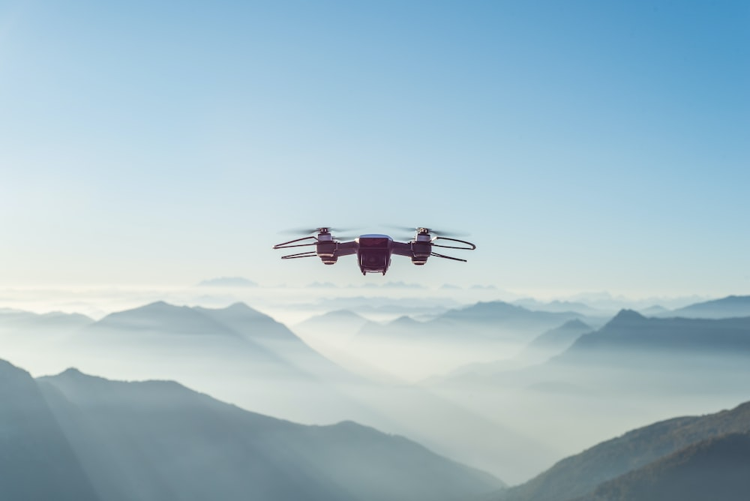
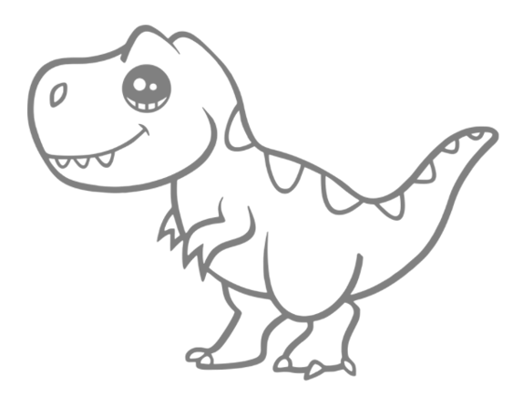
Anti-drone System
System modelling class
18.01.23
T-Rex Squad

Slide 2

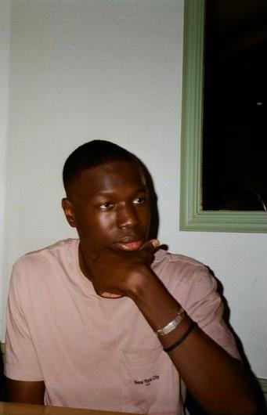




TEAM PRESENTATION
Hardware Chief Engineer : Adam WILHELM
Test Chief Engineer:
Bandiougou N’DIAYE
Documentation manager : Weimin CAO
Project manager : Camilla COLAS
Software Chief Engineer :
Ye CHEN
Project manager : Clémence LORANT
2

Slide 3
TABLE OF CONTENTS
01
INTRODUCTION About our project
02
03
CODE STRUCTURE Classes, functions, why…
04
05
HARDWARE DESCRIPTION What we did and why
SPECIFICATION TESTS & REVIEWS Passes and fails
PROBLEMS ENCOUNTERED
How we solved them
3

Slide 4
INTRODUCTION
4

Slide 5
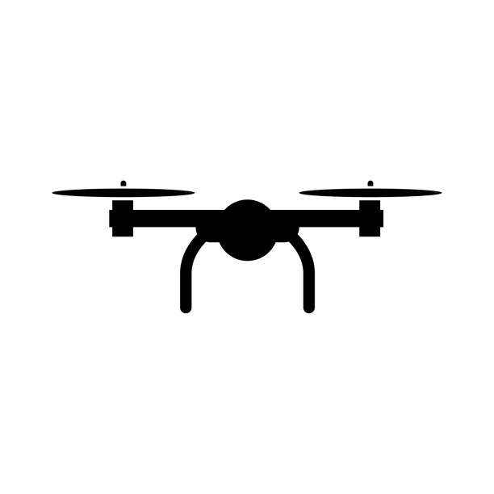
INTRODUCTION about the project
We want a robot that can detect and fire at flying drones.
It should be able to :
Scan the sky, discriminate and prioritize targets
Shoot the target taking into account its altitude/elevation
→ The flying drones are going to be modelled by plastic red balls in our tests
= =
5

Slide 6
INTRODUCTION about the project
The robot has to scan the sky of a rectangular base.
We place the robot in the middle of one of the longest sides, so that the robot only has to scan its environment on 180° horizontally and 45° vertically .
Drones
Basis to scan
180°
Our robot
6

Slide 7
HARDWARE DESCRIPTION
7

Slide 8
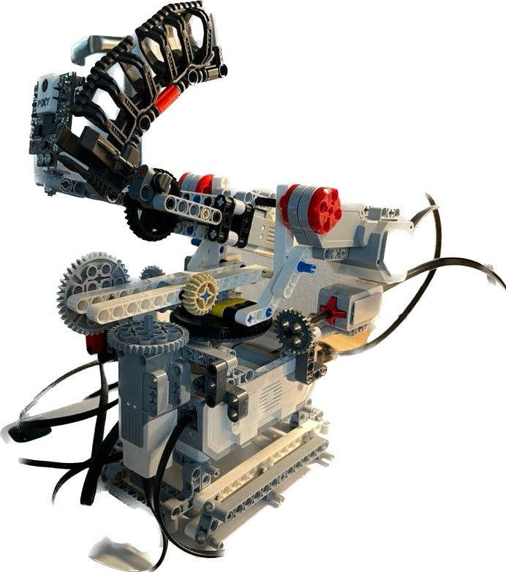






HARDWARE DESCRIPTION what we did
Pixy 2 Camera
Launcher
Components :
1 Pixy2 Camera
4 Motors
1 Launcher
2 Buttons
1 Ev3 controller
Button
Motor
Gearing
Stability platform
8

Slide 9
HARDWARE DESCRIPTION what we did
THE MOTORS :
The rotation : Three motors for the rotation (one for the rotation axis and two for the vertical axis.)
Shooting : bullets are fired at the target by the actions of a motor.
THE TWO BUTTONS:
They permitt to limit the rotation of the camera and the launcher at 180° horizontally.
9

Slide 10
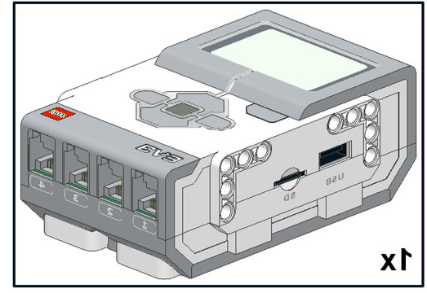
HARDWARE DESCRIPTION what we did
EV3 Controller
Central controller using Pixy mode
Using Pixy mode.
Control sensors and motors
Use to detect target and calcul the distance
10

Slide 11
CODE STRUCTURE
11

Slide 12
SOFTWARE DESCRIPTION what we did
tracking
Begin
scanning
False
target
detected
True
True
target
lost
False
False
right
calibration
True
12
shooting

Slide 13
SOFTWARE DESCRIPTION Scanning Function
The motor turns until it touches the buttons.
We scan 180°
When it touches the button, it changes the value of our variable
When the value is negative, we turn right
When it is positive, we turn left
Button
13

Slide 14
SOFTWARE DESCRIPTION tracking
Block = Pixy2.gee_blocks(3,255)
With 3 = signation number of green (2) + signation number of red (1)
255 = target number
14

Slide 15
SOFTWARE DESCRIPTION tracking
If we have more than one target, we chose the closest one.
We center the target, if the conditions are respected, we shoot only one time.
20
208
20
158, 104
15
316

Slide 16
SOFTWARE DESCRIPTION Shooting
If Flag_Shoot = True
We activate the motor for the shooting and shoot once
Just after shooting we have Flag_Shoot = False
Shooting motor
16

Slide 17
SPECIFICATIONS TESTS & REVIEWS
17

Slide 18
SPECIFICATION TESTS Gold target
The robot is able to discriminate and prioritize targets, and shoot the first one
detected.
The robot is able to shoot the target considering its altitude/elevation. To be shoot
correctly, the target must be within 60cm of the robot.
Condition of test:
Test 1: We have two red balls. One that arrives sooner than the other.
Test 2: We change the altitude and the distance of the red ball
18

Slide 19
SPECIFICATION TESTS Gold target
The robot only has to scan its environment on 180° horizontally and 45° vertically .
Drones
Basis to scan
180°
Our robot
19

Slide 20
SPECIFICATION TESTS Gold target
Actions:
Set the robot.
Verifications:
Test 1: The robot should aim at the closest ball.
Test 2: The robot should be able to touch the ball whether the altitude/distance
changes or not
20

Slide 21
DIFFICULTIES
21

Slide 22
DIFFICULTIES
We changed more than once our robot architecture
We have a problem with the scanning function because we have not enough power in our motors
Initially trouble communicating in the group
3 students doing an apprenticeship
22

Slide 23
DEMONSTRATION
23

